Slide 1
Playing with the Gamepad API
Web Development
Introduction to the JavaScript API to manage joysticks and game controllers

Slide 2
AGENDA
Introduction
What is the Gamepad API
How it Works?
Developing with the API
Demos

Slide 3

Introduction

Slide 4

Hello, my name is Alvaro!
I am a Spanish software engineer living in Austin, Texas.
I currently work as a Senior Developer at GM. I am passionate about web technologies, especially HTML and CSS.

Slide 5

What is the Gamepad API

Slide 6
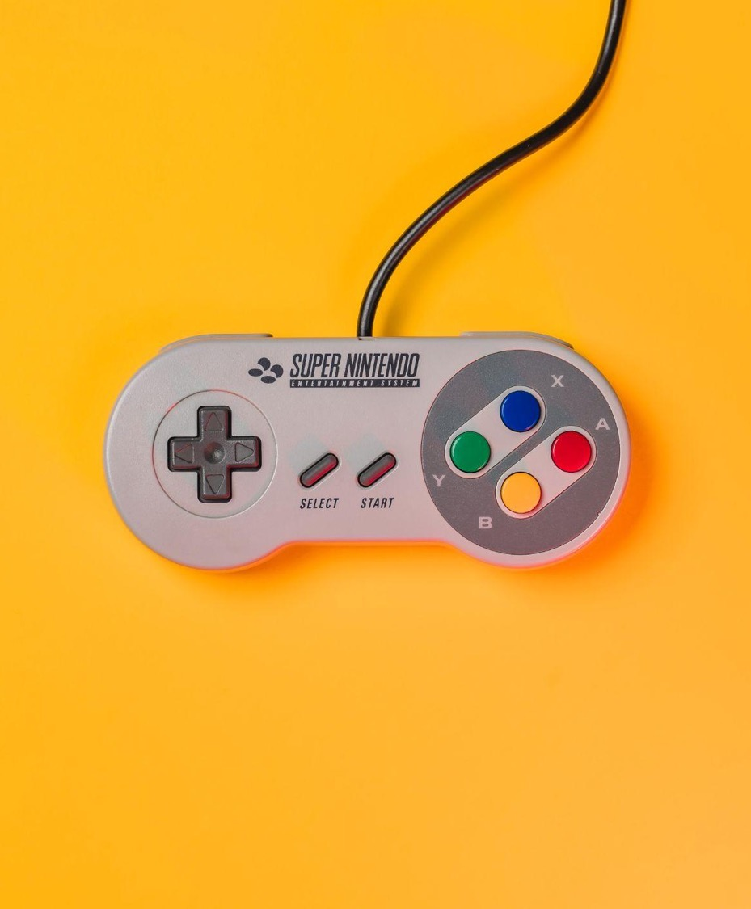
Gamepad API
JavaScript interface that handles game controllers connected to a web browser.
Provides basic events and allows reading controller state.
Standard: https://www.w3.org/TR/gamepad/

Slide 7
SUPPORT
95%
of web browsers (for desktop or mobile) support the Gamepad API …even without prefixes!

Slide 8

How does it work?

Slide 9
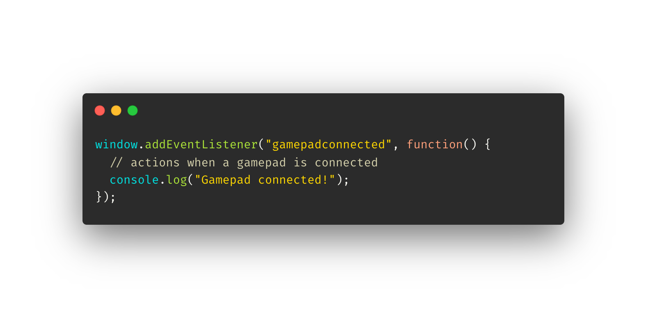

Slide 10


Slide 11
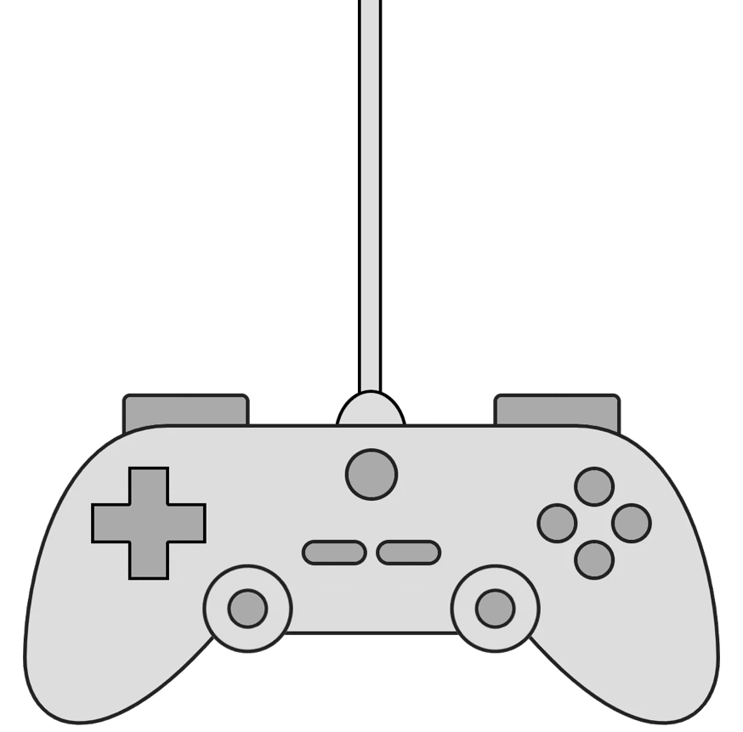

Slide 13
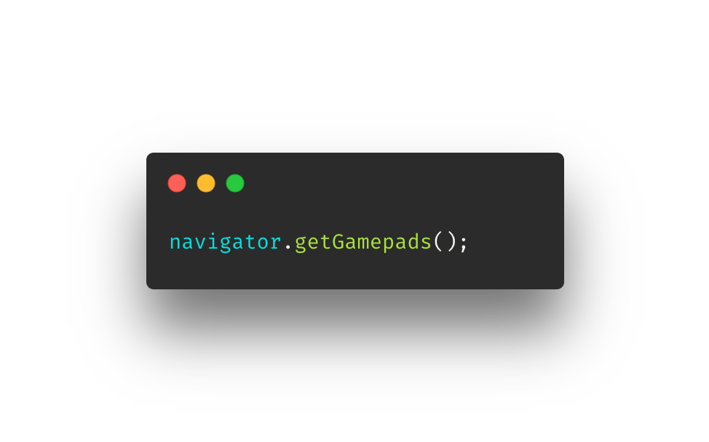
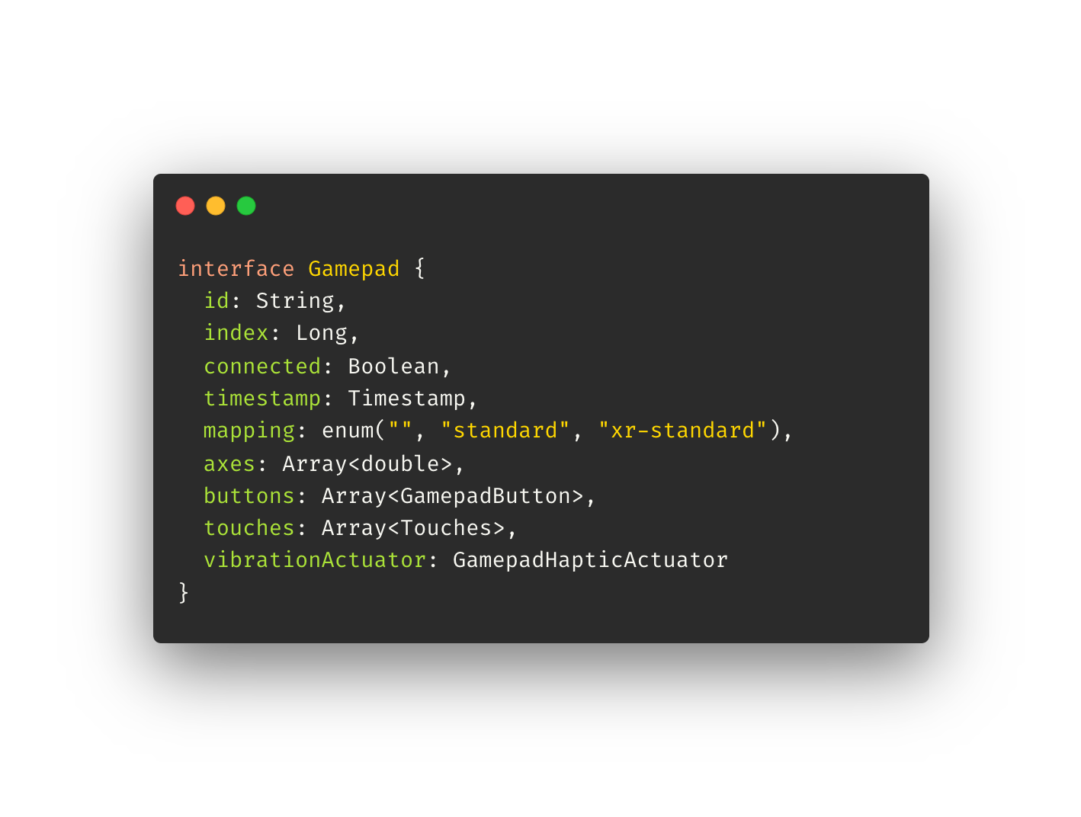
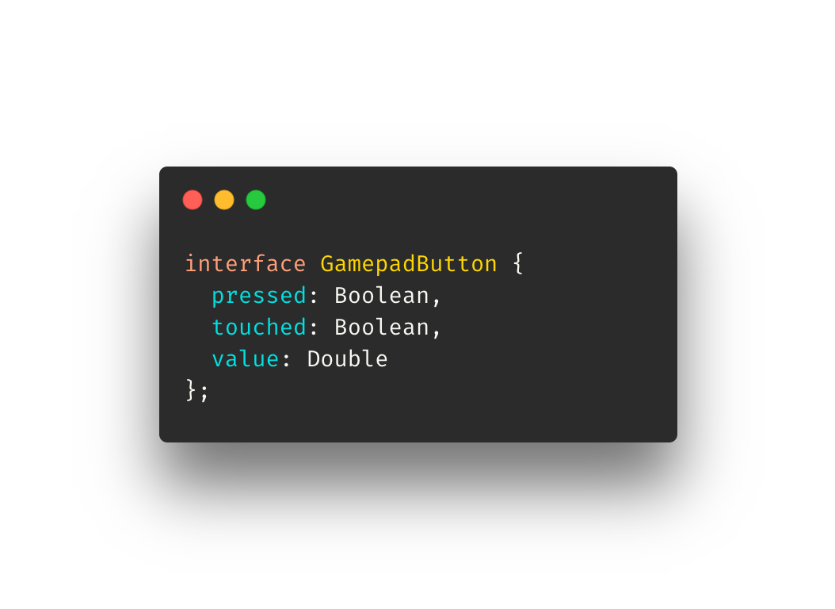

Slide 14
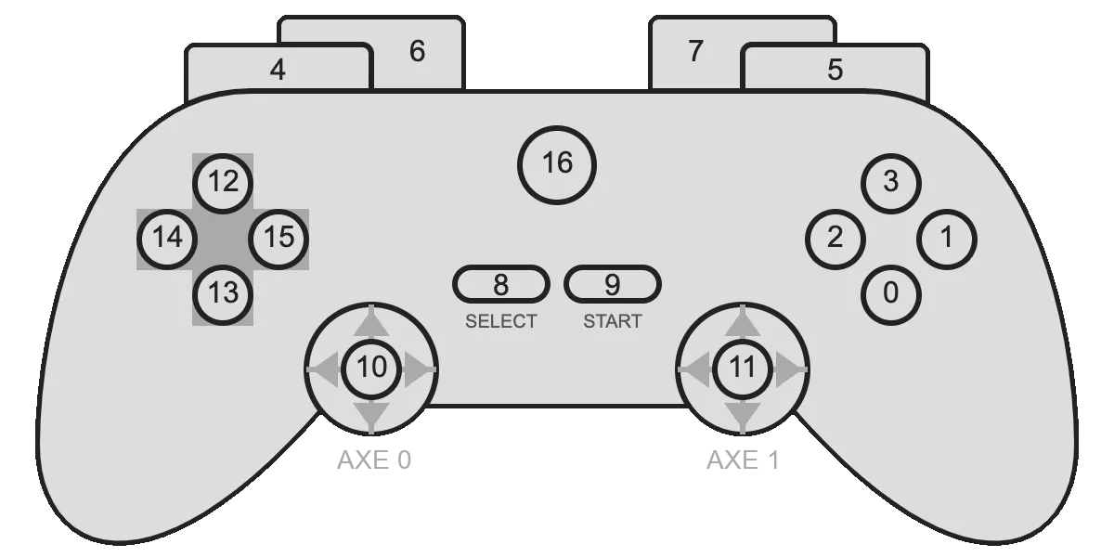

Slide 15

Developing with the Gamepad API

Slide 16
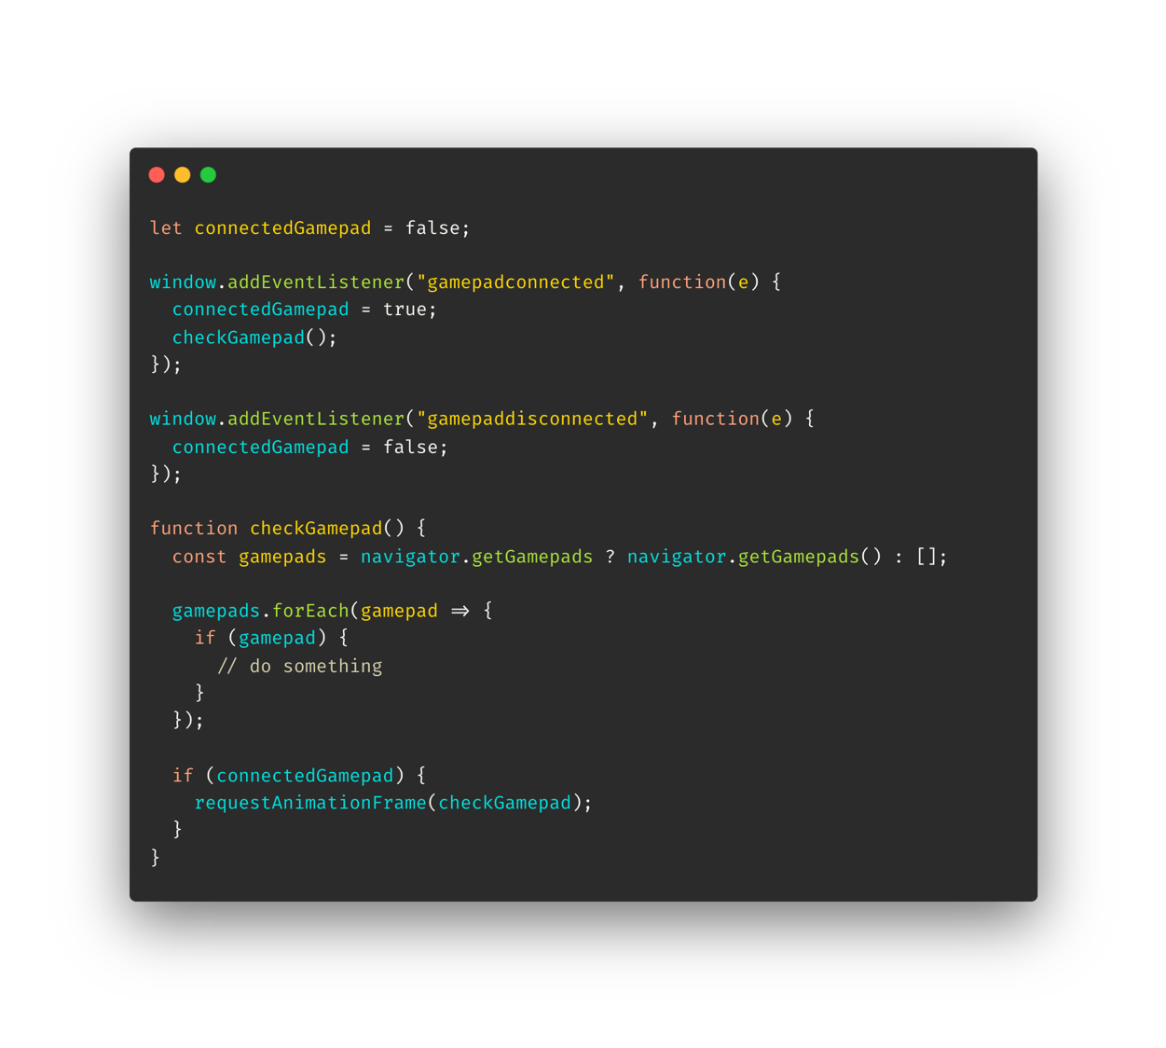

Slide 17

BUTTONS
Array of Button objects
It can change with the gamepad
…but compatible on every browser

Slide 19
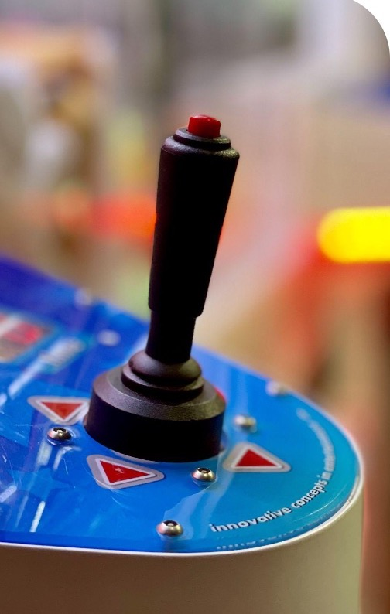
JOYSTICK
Array of numbers
Even indexes are horizontal
Odd indexes are vertical
…Beware of old browser versions!

Slide 20
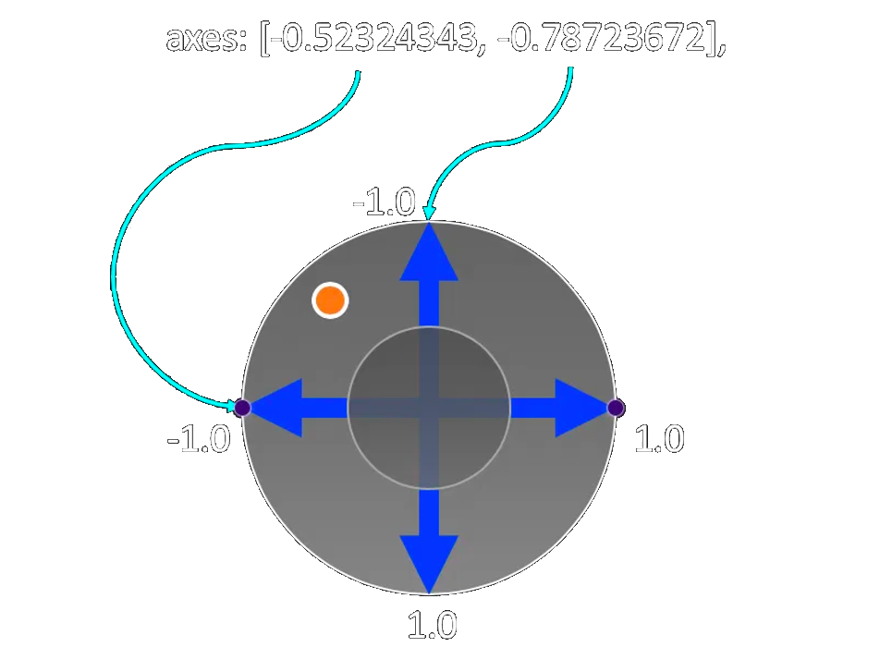

Slide 21

VIBRATION
Not available on all gamepads
Define:
Duration
Intensity
Changes by browser :(

Slide 22
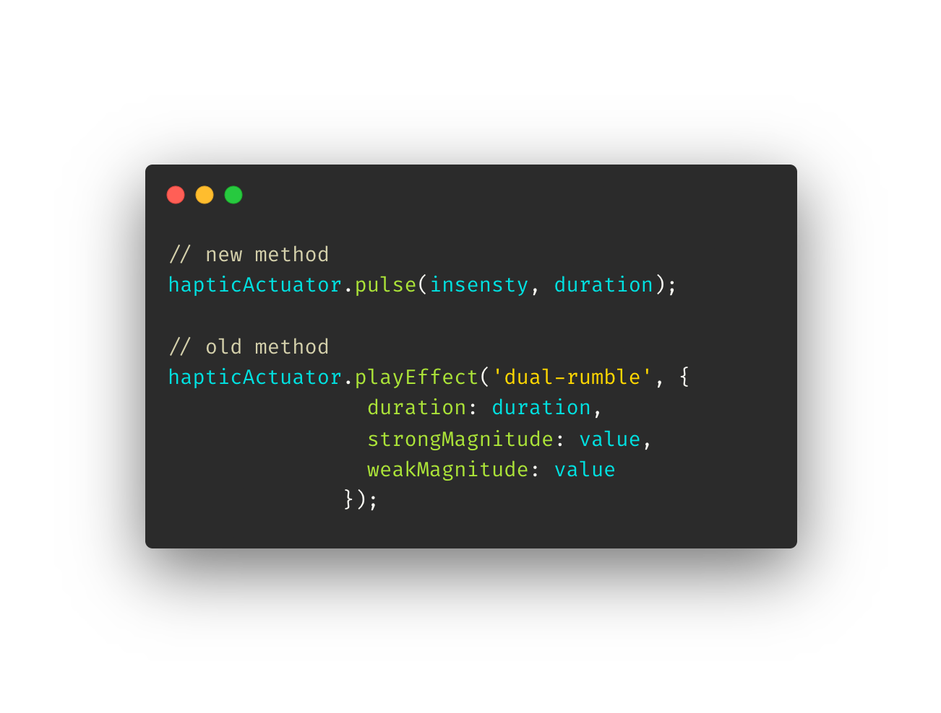

Slide 23

THANK YOU!

Slide 24
Demos

Slide 25
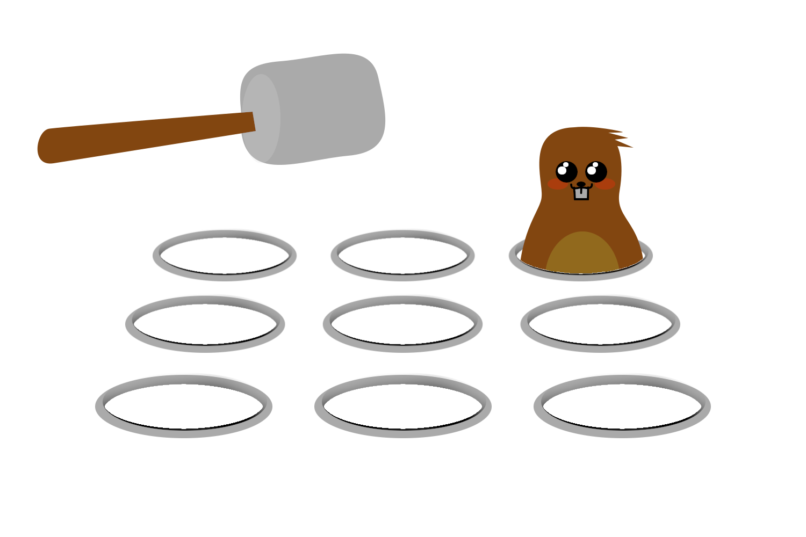

Slide 26
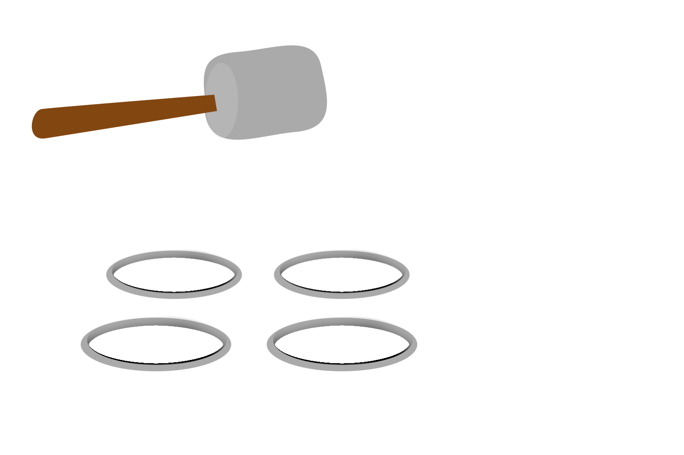

Slide 27
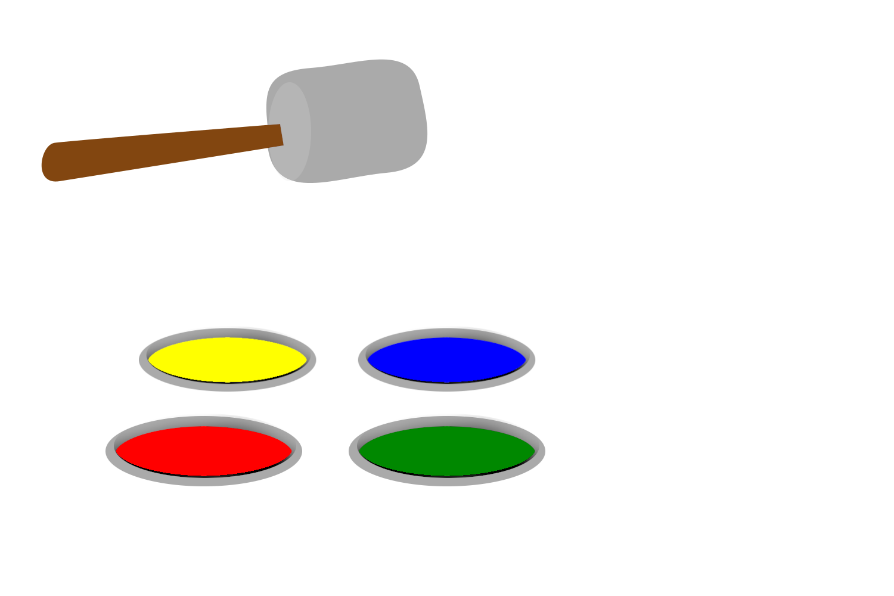

Slide 28
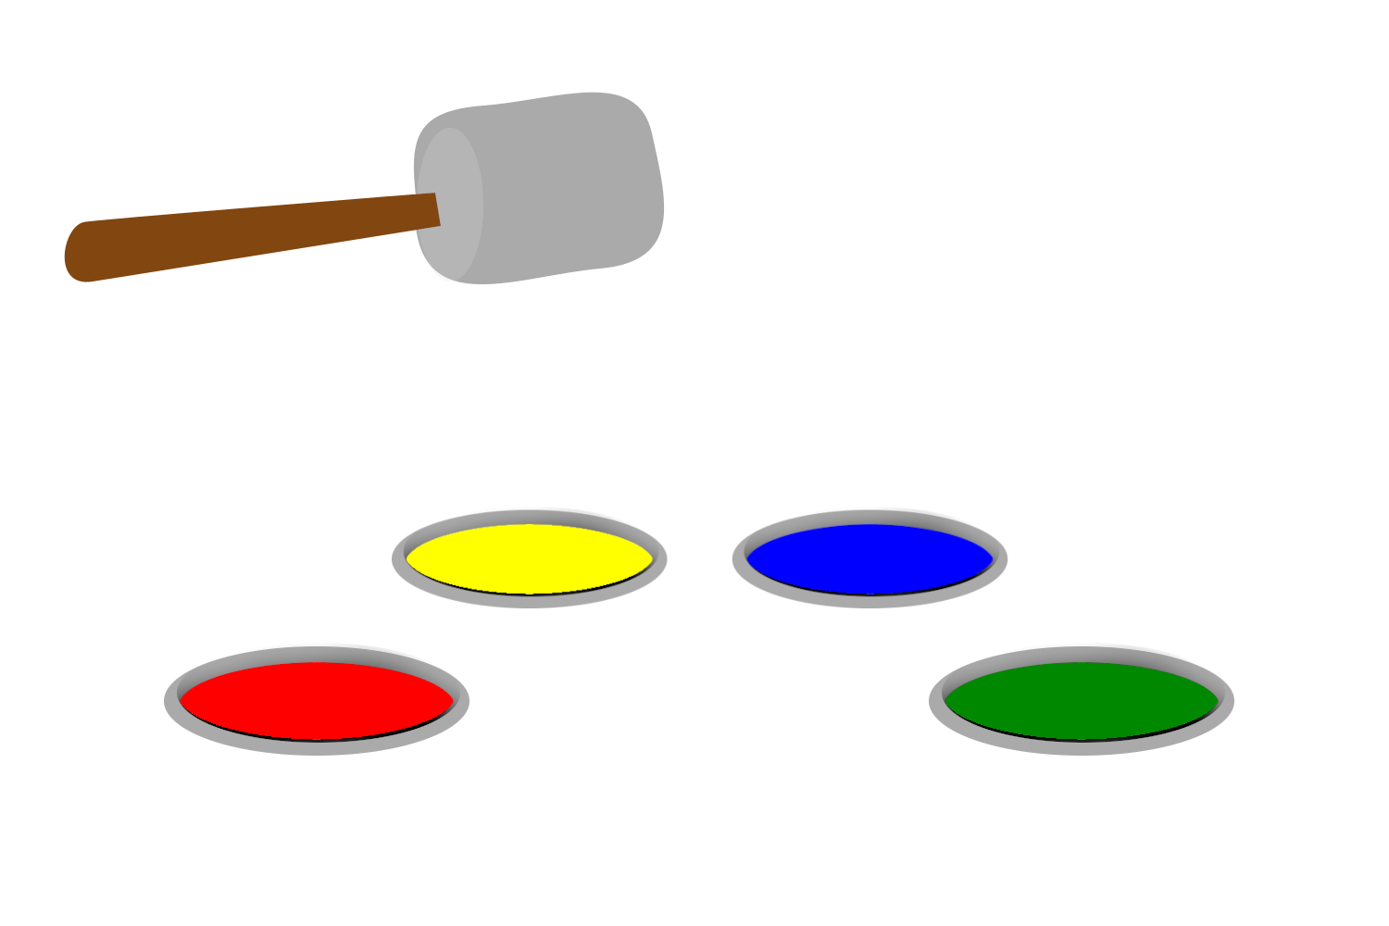

Slide 29
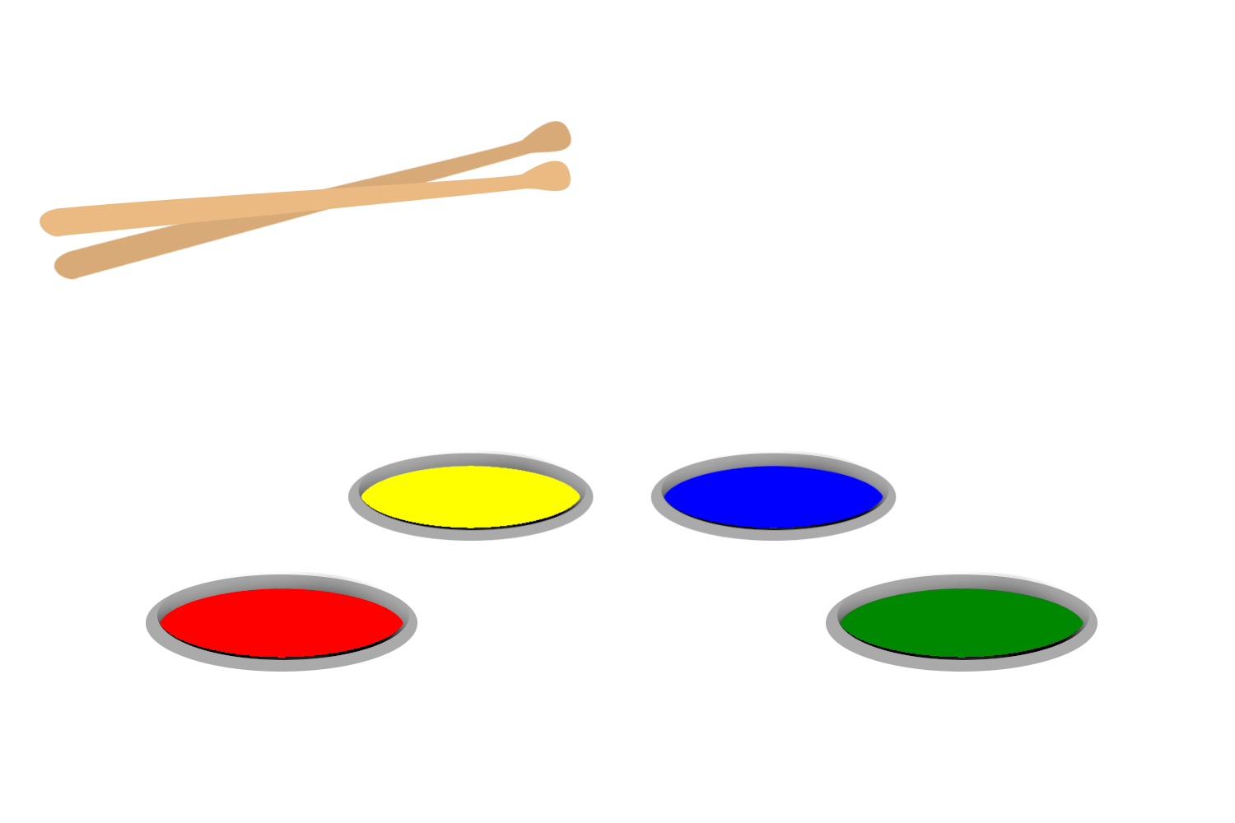

Slide 30
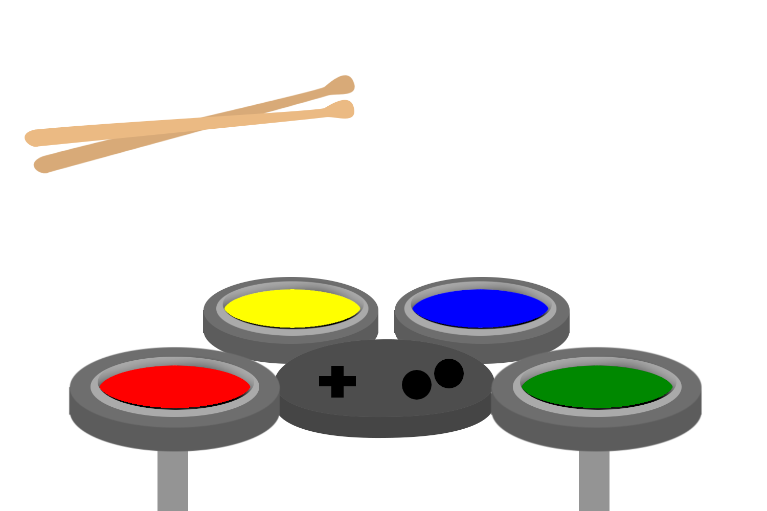

Slide 31
DEMOS
Rock Band / Guitar Hero
SNES Controller
Arkanoid / Block breaking game
Super Pepe Bros (Joystick demo)

Slide 32
Links

Slide 33
LINKS
Gamepad API standard
Gamepad API tutorial (MDN)
Develop a Rock Band game with HTML and JS

